Slide 1

Exploratory Data Analysis of FDA Drug Reaction Dataset Using Dask & Spark
Dec 11, 24
Breaking Bad - Roehit Ranganathan Abhinav Sivanandhan
CS-GY 6513 Big Data Fall 2024

Slide 2

AGENDA
• Project Overview
• Dataset Details
• Tools & Technologies
• Data Preprocessing
• Data Cleaning
• Conversion to Parquet
• Exploratory Data Analysis (EDA)
• Key Insights & Visualizations
• Challenges & Solutions
• Conclusion & Future Work
Breaking Bad
Exploratory Data Analysis

Slide 3

Project Overview
Objective
To explore and analyze the FDA Drug Reaction Dataset from OpenFDA.
Goal
Extract insights on adverse drug reactions, drug usage trends, and associated patterns.
Tools
Dask, Spark, PyArrow, and Pandas for data manipulation and processing.
Data Sources
Unzipped from FDA-provided dataset files.
Breaking Bad
Exploratory Data Analysis

Slide 4

Dataset Details
• Source: FDA’s OpenFDA Drug Reaction Reports
• Original Dataset:
• Total Files: 1568 files
• Total Size: 102.2 GB
• File Format: Compressed .json.zip
• Post Unzipping:
• Total Files: 1568 files
• Total Size: 516.32 GB
• File Format: Uncompressed .json files with nested structures
• Data Schema:
• Fields like safetyreportid, drug name, reaction, outcome, reporter country, etc.
• Nested Fields: Some fields like patient and drug have nested structures.
Breaking Bad
Exploratory Data Analysis

Slide 5




Tools & Technologies
Tool | Purpose
Dask | File handling, parallel computation
Spark | Distributed EDA, Parquet conversion
PyArrow | Parquet file generation
Pandas | Data validation, local inspection
JSON | Data format for raw files
Snappy | Parquet file compression
Breaking Bad
Exploratory Data Analysis

Slide 6
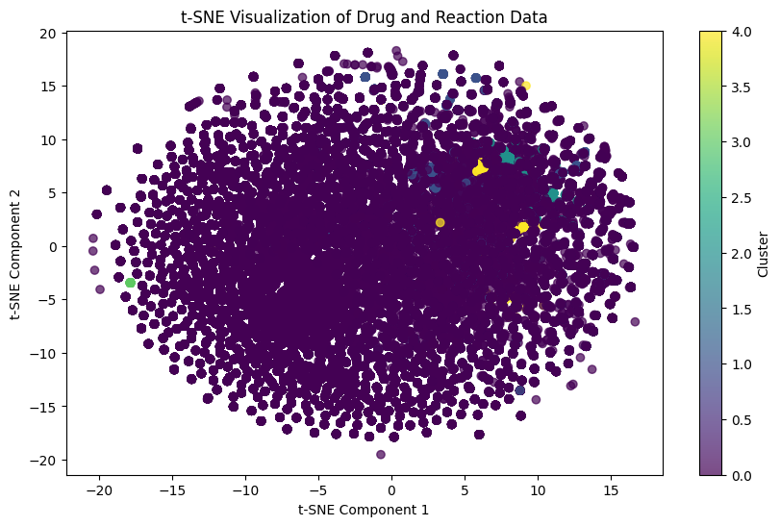
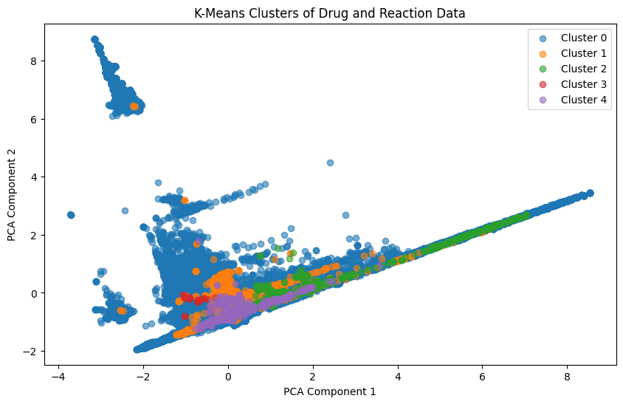
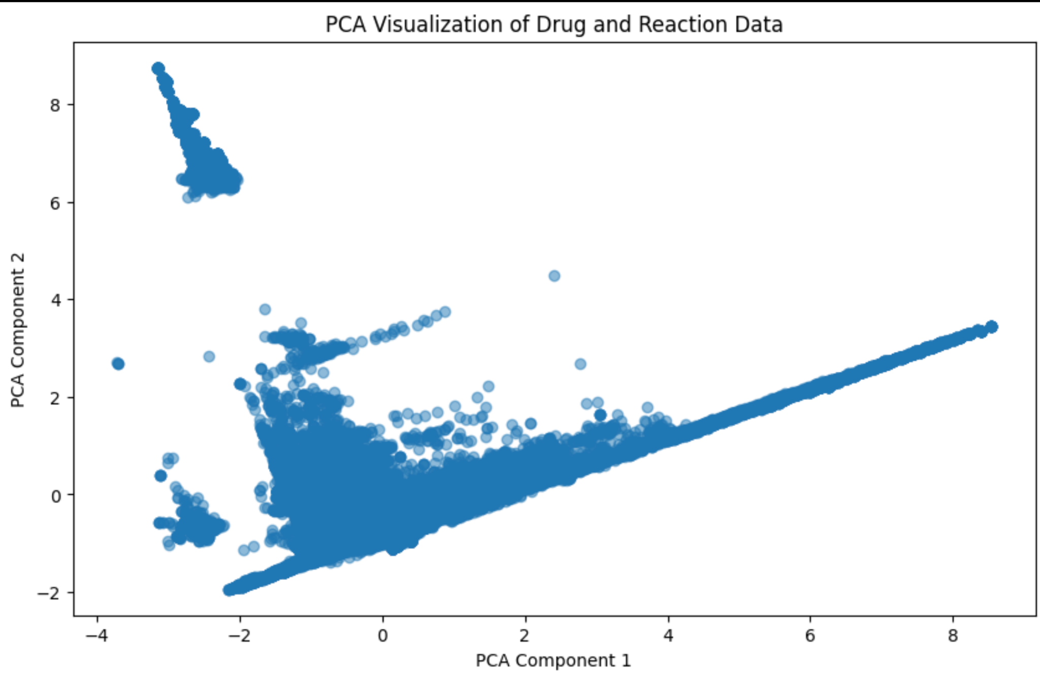
Data Preprocessing
Content:
• Step 1: Extract JSON files from compressed .zip files using Dask/Spark.
• Total data size increased from 102 GB to 516 GB.
• Step 2: Folder Structure
• Original structure:
Sampler/
├── 1-drug-event-0001-of-0005.json/
│ └── drug-event-0001-of-0005.json
├── 2-drug-event-0002-of-0005.json/
│ └── drug-event-0002-of-0005.json
• Unzipped structure:
Sampler/
├── 1-drug-event-0001-of-0005.json/drug-event-0001-of-0005.json
├── 2-drug-event-0002-of-0005.json/drug-event-0002-of-0005.json
Breaking Bad
Exploratory Data Analysis

Slide 7
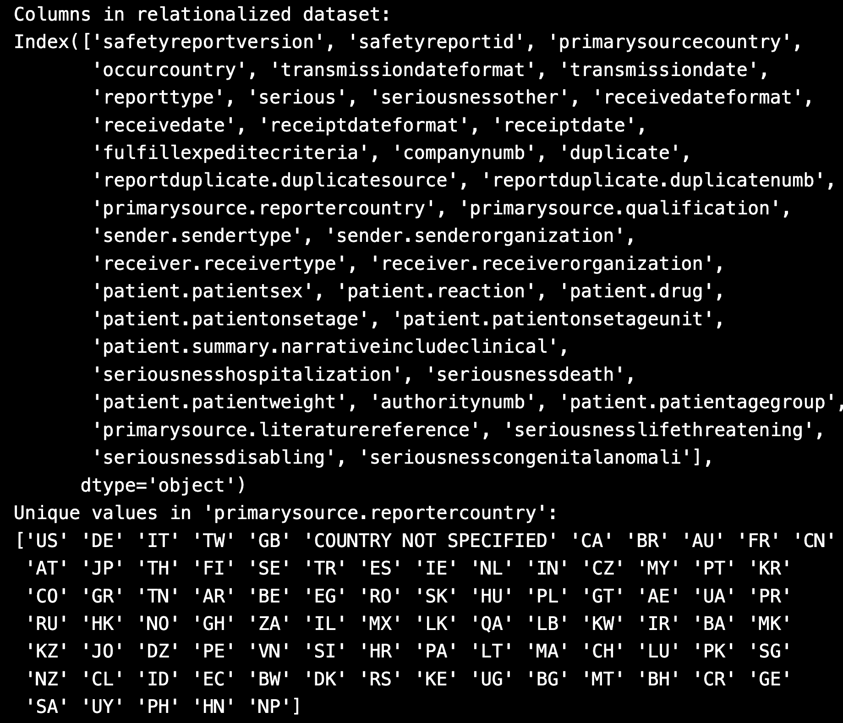
Data Cleaning
Fields Removed to Improve Performance:
rxcui
product_ndc
spl_id
spl_set_id
package_ndc
nui
application_number
Challenges Encountered:
Missing or corrupted JSON files
Empty files or files with errors in current pipeline
Solution:
Skipped invalid files
Logged errors to error_log.txt
Breaking Bad
Exploratory Data Analysis

Slide 8
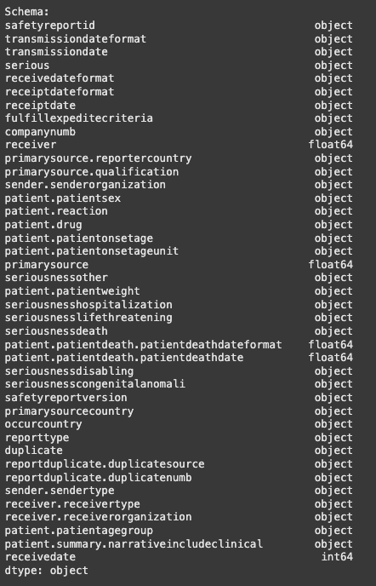
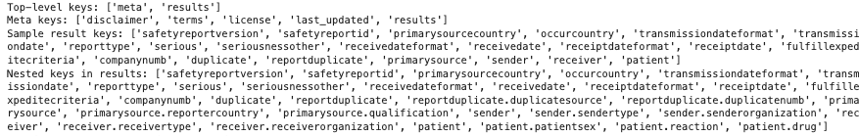
Conversion to Parquet
Content:
• Reason for Conversion:
• Parquet is a columnar format that supports efficient storage and query performance.
• Compressed using Snappy.
• Space Savings: Reduced file size significantly.
• Parquet Conversion Steps:
• Each JSON file was serialized and converted to a Parquet file with Snappy compression.
• The output Parquet files were stored in the Sampler_output/ directory.
Breaking Bad
Exploratory Data Analysis

Slide 9
Exploratory Data Analysis (EDA)
Content:
• Performed summary statistics on key fields:
• Number of unique drugs
• Frequency of reactions (most common reactions)
• Drugs with most adverse reactions
Techniques Used:
• Dask for distributed computation of large Parquet files.
• DuckDB for metadata related queries.
• Pandas for local inspection of results.
Breaking Bad
Exploratory Data Analysis

Slide 10
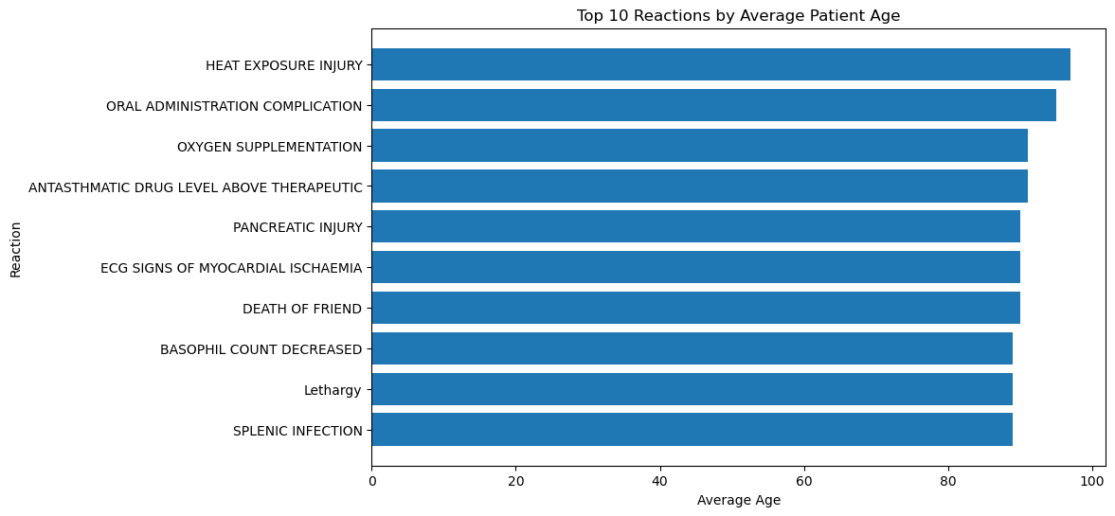
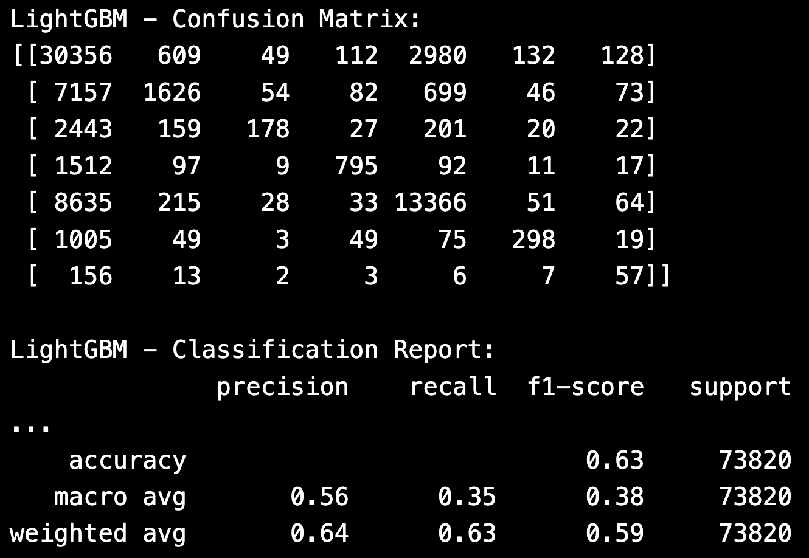
Key Insights
Content:
• Top Drugs: Most frequently reported drugs with adverse reactions.
• Most Common Reactions: Insights into the most common reactions reported.
• Report Trends: Geographical trends in report submission.
• Data Size Reduction: File size reduced from over 600 GB to ~15 GB.
Breaking Bad
Exploratory Data Analysis

Slide 11
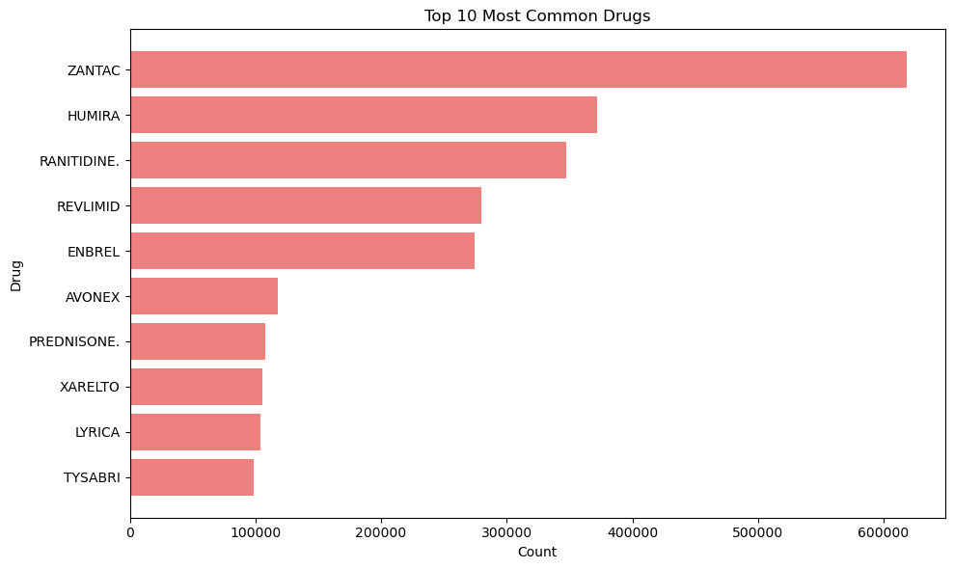
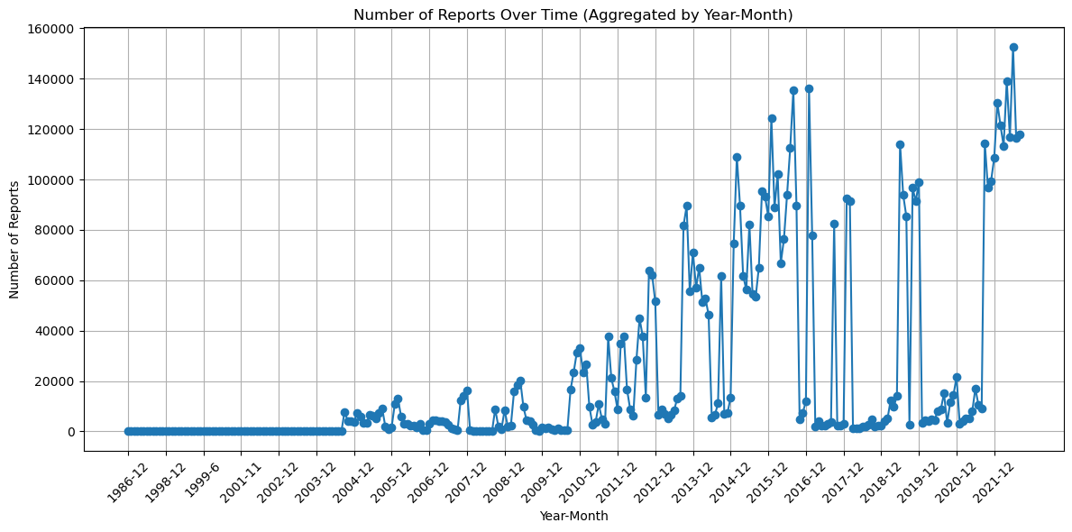
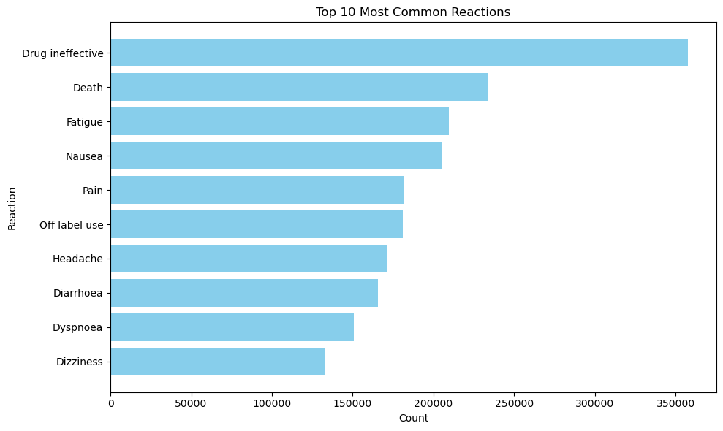
Visualizations
Visualisations:
1. Bar chart of the most frequently reported adverse reactions.
2. Pie chart of the top 10 drugs associated with reports.
3. Line chart showing the number of reports over time.
Breaking Bad
Exploratory Data Analysis

Slide 12
Challenges & Solutions
Challenges:
• Corrupted JSON files with “Expected object or value” error.
• Memory constraints when processing large files (16GB system memory).
• Performance bottlenecks when processing nested JSON files.
Solutions:
• Used PyArrow for direct Parquet conversion.
• Handled errors and logged bad files for review.
• Optimized file processing with Dask parallelization.
Breaking Bad
Exploratory Data Analysis

Slide 13
Conclusion & Lessons Learned
Lessons Learned:
• The value of using Parquet files for space and performance.
• How to handle corrupted files and track errors using Dask.
• Efficiently process large nested JSON files using Dask and PyArrow.
Future Work:
• Further clean the dataset by identifying and excluding outliers.
• Automate EDA processes to run on new datasets.
Breaking Bad
Exploratory Data Analysis

Slide 14
Q & A
Breaking Bad
Exploratory Data Analysis

